Slide 1
Name: Shelby Roe
Chapter Name: Penta Career Center-ECE
School: Penta Career Center
City: Perrysburg
Event Name: Teach and Train
Project Name: Chicka Chicka Boom Boom

Slide 2
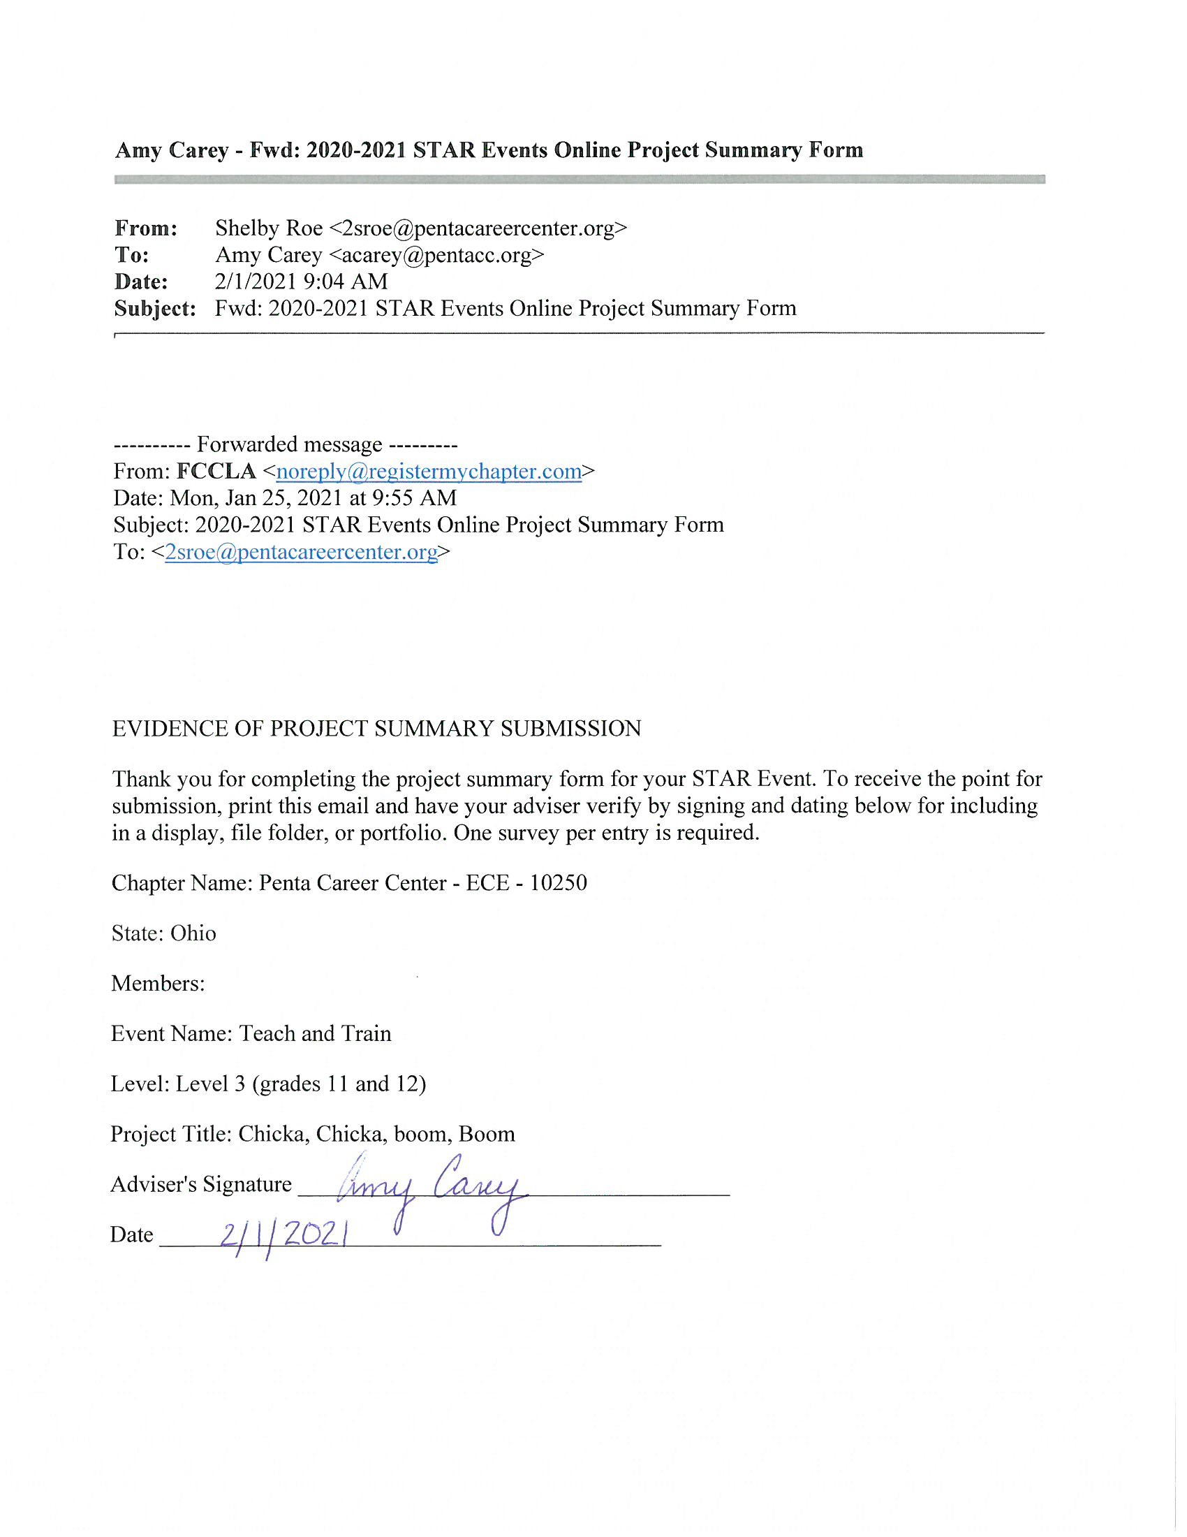
Evidence of Online Project
Summary Sheet

Slide 3
Goal 1: Planning Process
Identify Concerns | My concern is that I have not obtained enough knowledge of how to run a Second Grade classroom as the lead teacher and that I need more experience in the career field of Early Childhood Education to help guide me into my future career.
Set A Goal | By using the Teach and Train criteria, my goal is to pursue a career in becoming an elementary grade teacher by obtaining my 4 year degree at a local college. I will also plan and carry out an alphabet themed day to teach preschool children with projected 90% accuracy.
Form A Plan | Who: Myself, Advisors, Classmates/Fellow FCCLA members, Mrs. Feehan Second Grade Teacher, Mrs Thorp Preschool Teacher, the second grade and preschool students. What: Shadow a second grade teacher, create a portfolio based on the criteria in the Star Event Manual and Teach and Train guidelines, plan a full lesson plan based off the book, Chicka Chicka Boom Boom, and complete activities with preschool students. Where: Penta Career Center Preschool Classroom, an Otsego Elementary School’s Second Grade Classroom, and Penta Career Center. How: Work on my portfolio and lesson plans at least twice a week, arrange plans to shadow a second grade classroom, create and implement a lesson plan for preschoolers, ask for help from my advisors and teachers, and follow the Teach and Train Manual. Cost: The total cost of supplies for the snack will come to $30 and other supplies are already provided in the classroom. Resources: My teachers and advisors, FCCLA website, and previous Teach and Train portfolios. Evaluation: Received information from my advisors, teachers, and fellow FCCLA members and classmates. Discovered that I had to change up my plans a little bit due to Covid by attending Zoom classes and creating social distanced activities.

Slide 4
Goal 1: Planning Process
Act | - Talk to my advisors, Mrs. Dova Zak and Mrs. Amy Carey - Followed the criteria in the Teach and Train Star Event Manual - Shadowed a second grade teacher - Talked with the teacher and her students about their classroom, assignments, and expectations - Planned, wrote, and conducted my lesson plans with the preschoolers - Used the computer to create my portfolio pages - Showed proof of Use of Technology and proof of shadow - Put my portfolio together following the specifications in the judging rubric provided - Practiced my presentation with my advisors, teachers, and fellow FCCLA members and classmates
Follow Up | -I completed my lesson on November 5th, 2020 and implemented it into the classroom on November 12th, 2020. It went pretty smoothly. There were a few things I could’ve done differently to make it flow better. -I completed my job shadow on November 13th, 2020, but COVID-19 stopped me from being able to directly work with the children. -I completed my portfolio in the beginning of February 2021 and learned about the requirements, responsibilities, and duties of a preschool teacher.

Slide 5
Table of Contents
Project Identification Page Slide 1
Evidence of Online Project Summary Sheet Slide 2
FCCLA Planning Process Summary Page Slide 3-4
Table of Contents Slide 5
Career Exploration Summary Slide 6-9
Self-Assessment Document Slide 10-11
Lesson Plans Slide 12-22
Evidence of Prior Presentations Slide 23-29
Evidence of Technology Used Slide 30-32
Work Cited Slide 33-34

Slide 6
Career Exploration

Slide 7
Career Exploration
Elementary Teacher
Educational Path and Qualifications: To become an elementary teacher in Ohio, a person will need a bachelor’s degree in Early Childhood Education. In addition, they will need to pass a criminal background check along with being fingerprinted. They also need to complete an approved teacher preparation program and pass a content area exam and a professional knowledge exam. They must apply for initial licensure through the Ohio Department of Education.
Sample Job Description: An Elementary Teacher is responsible for providing a safe and developmentally appropriate classroom in accordance with all relevant legislation, policies, and procedures in which a child can properly learn and grow in. Their primary duties include developing learning materials, teaching, answering student inquiries, assigning homework, and managing classroom supplies.
Skills Needed:
Dependable
Positive
Caring
Innovative
Creative
Outgoing
Flexible
Positive attitude
Should enjoy challenges and have room to grow
Take initiative in the classroom
Can handle several activities at once
Be a keen observer
Enthusiastic

Slide 8
Career Exploration
Elementary Teacher
Current and Future Job Outlook: Overall employment of elementary teachers is projected to grow 4% from 2019 to 2029, about as fast as the average for all occupations. Rising student enrollment should increase a demand in elementary teachers, but employment growth will vary by region, according to the U.S. Bureau of Labor Statistics website.
Mentorship: Some measures I could take to ensure a long, enjoyable, and successful career as an elementary teacher could be to follow a mentor and take their advice. A good mentor for me would be Amy Carey, the Early Childhood Education lab teacher at Penta Career Center and previous elementary teacher. She would make a good mentor for me because she has many years of experience. Mrs, Carey had the ultimate goal of being a teacher like I do. She has completed her degree and has acquired additional degrees as well. I am grateful for the opportunity to learn through her and her experiences. She has lots of teaching experience and advice to guide me through my journey.
Entry-Level Positions and Opportunities for Professional Advancements: Teachers can advance to a masters degree with classroom experience and education. After a teacher’s initial four year license, they can renew to a professional teaching license which is valid for five years.

Slide 9
Education
Two Year Associates In Early Childhood Education
Four Year Early Childhood Education Degree
Day Care
Head Teacher
-Director
Head Start
-Teacher
-Elementary Teacher Aide
Pay Average
$20,140-39,100
Elementary Teacher
Pre-K - 5th grade
Day Care
-Head Teacher
-Director
Head Start
-Teacher Coordinator
Pay Average
$23,000-79,000

Slide 10
Self Assessment

Slide 11
Self Assessment
Personal Interests:
I am interested in being an elementary teacher because I enjoy working with young children and helping them learn. Some of the aspects I enjoy are listed below:
-Teaching young children new concepts
-Being a role model for children
-Watching children develop
Learning Style:
My learning style is Kinesthetic and Visual. I need to feel and be hands on with materials as well as observe the curriculum and content that I learn. This helps as an elementary teacher because young children also learn best by observing and feeling. With myself being the same, I can better prepare lessons and games that help the children learn in the most developmentally appropriate way for them.
Other Aspects of my Self-Assessment I Have Considered:
Besides being an elementary teacher with my CDA, I have considered going to college to get my Bachelor’s Degree in Early Childhood Education. I have also considered being a nanny or working in a daycare.
Personal Skills:
Out of the book, “Working with Young Children”, there is a list of characteristics of successful teachers. Some of those characteristics I believe apply to me are as follows:
-Fond of Children and Lots of Energy
-Creative and Positive Attitude
-Patient and Caring
-Good Problem Solver and Resourceful
-Loving and Compassionate
Career Value: Why a Career in Education (Elementary) Appeals to me:
Being an elementary teacher is very appealing to me for many different reasons. The most important reason to me is that I want to help children grow into the best students they can be. I want to be someone they can trust and look up to for guidance. I want to make them feel welcome and accepted. I want them to know that they are loved.

Slide 12
Lesson Plan

Slide 13
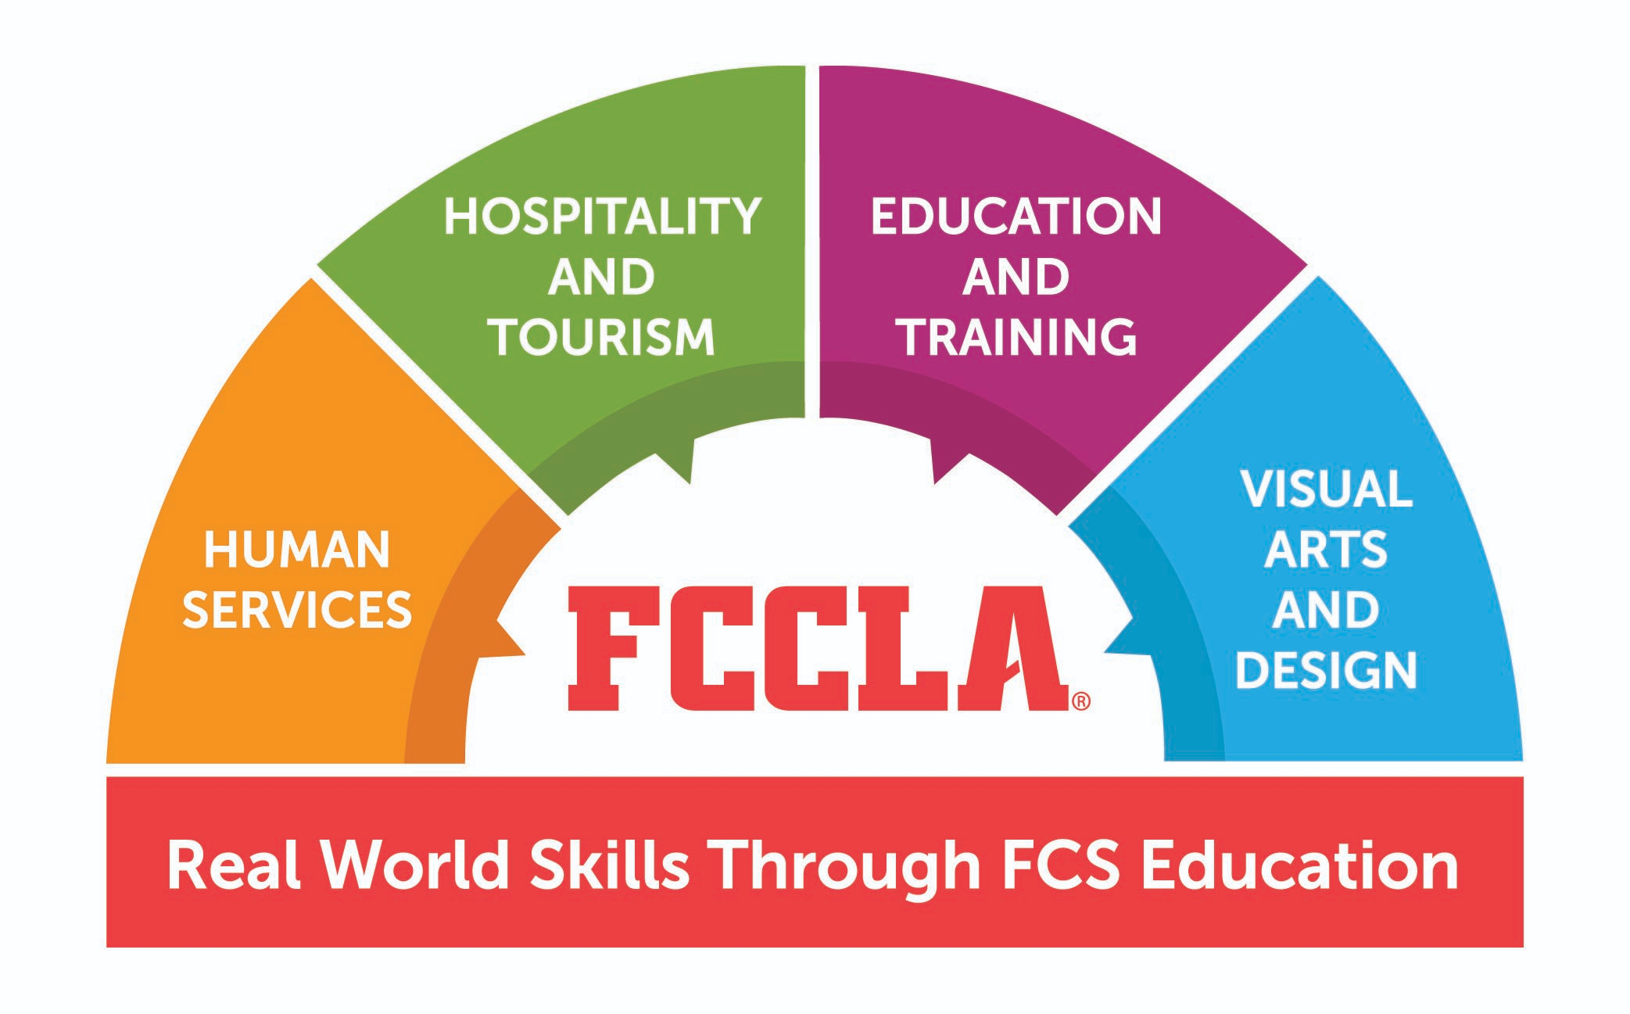
Relationship to Family and Consumer Sciences
The Early Childhood Education program at Penta Career Center is under the FCS Learning umbrella according to:
“Health, Safety, and Nutrition” (350230)
“Foundations of Education and Training” (350002)

Slide 14
Teach and Train
Lesson Plans
Presenter: Shelby Roe
Lesson Title/Topic: “Chicka Chicka Boom Boom”
Grade Level: 3-5 year olds
Timeframe: 2 hours
Learning Objective(s): After hearing the story “Chicka Chicka Boom Boom” by Bill Martin Jr. and John Archambault, the 3 to 5 year old preschool students will participate in a variety of activities within the classroom based on concepts of the alphabet, with 90% accuracy. These activities build from the story and the Ohio Early Learning Content standards.
Goals: The children will be introduced to the concept of fine motor activities, technology, letter recognition, sensory/art, math activities, science and english/writing based on the story and the Ohio Early Learning Content Standards.
Curriculum Standards Addressed: English/Writing- Reading the story helps students understand sequencing and memory. The painting activity helped the students with fine motor skills of holding a paintbrush and creatively painting a tree.
Math- The number tree activity helps students identify numbers by looking at them and learning subitizing by looking at a die.
Science/Sensory-Coconut exploration allowed the students to feel a real life object and learn inquiry skills.
Technology-The Chicka Chicka Boom Boom online activity had students use computers skills to complete the game and focus on problem solving skills.
Music/Movement-Students used their large muscles to move to music and work on their coordination skills.

Slide 15
Teach and Train
Lesson Plans Cont.
Career Readiness Practices:
Apply appropriate academic and technical skills.
Demonstrate creativity and innovation.
Utilize critical thinking to make sense of problems and persevere in solving them
Use of technology to enhance productivity.
Evaluation Methods: The children followed directions and participated in all activities. Their responses and interactions were great. I also completed a self evaluation form from Mrs. Ashley Thorp.
Conclusion: The children have learned skills through the book and many activities that followed. They enjoyed the activities and many wanted to do it again
Plans to Improve Lesson: To improve this lesson for future use, I would consider having more hands on activities and I would also prepare for the day better by having more time to set up before class and practicing running through the activities beforehand to prepare a better activity experience.
Assessment: Observation of the children following directions. Summative assessment was done by comparing the outcome against the Ohio Early Learning Standards.

Slide 16
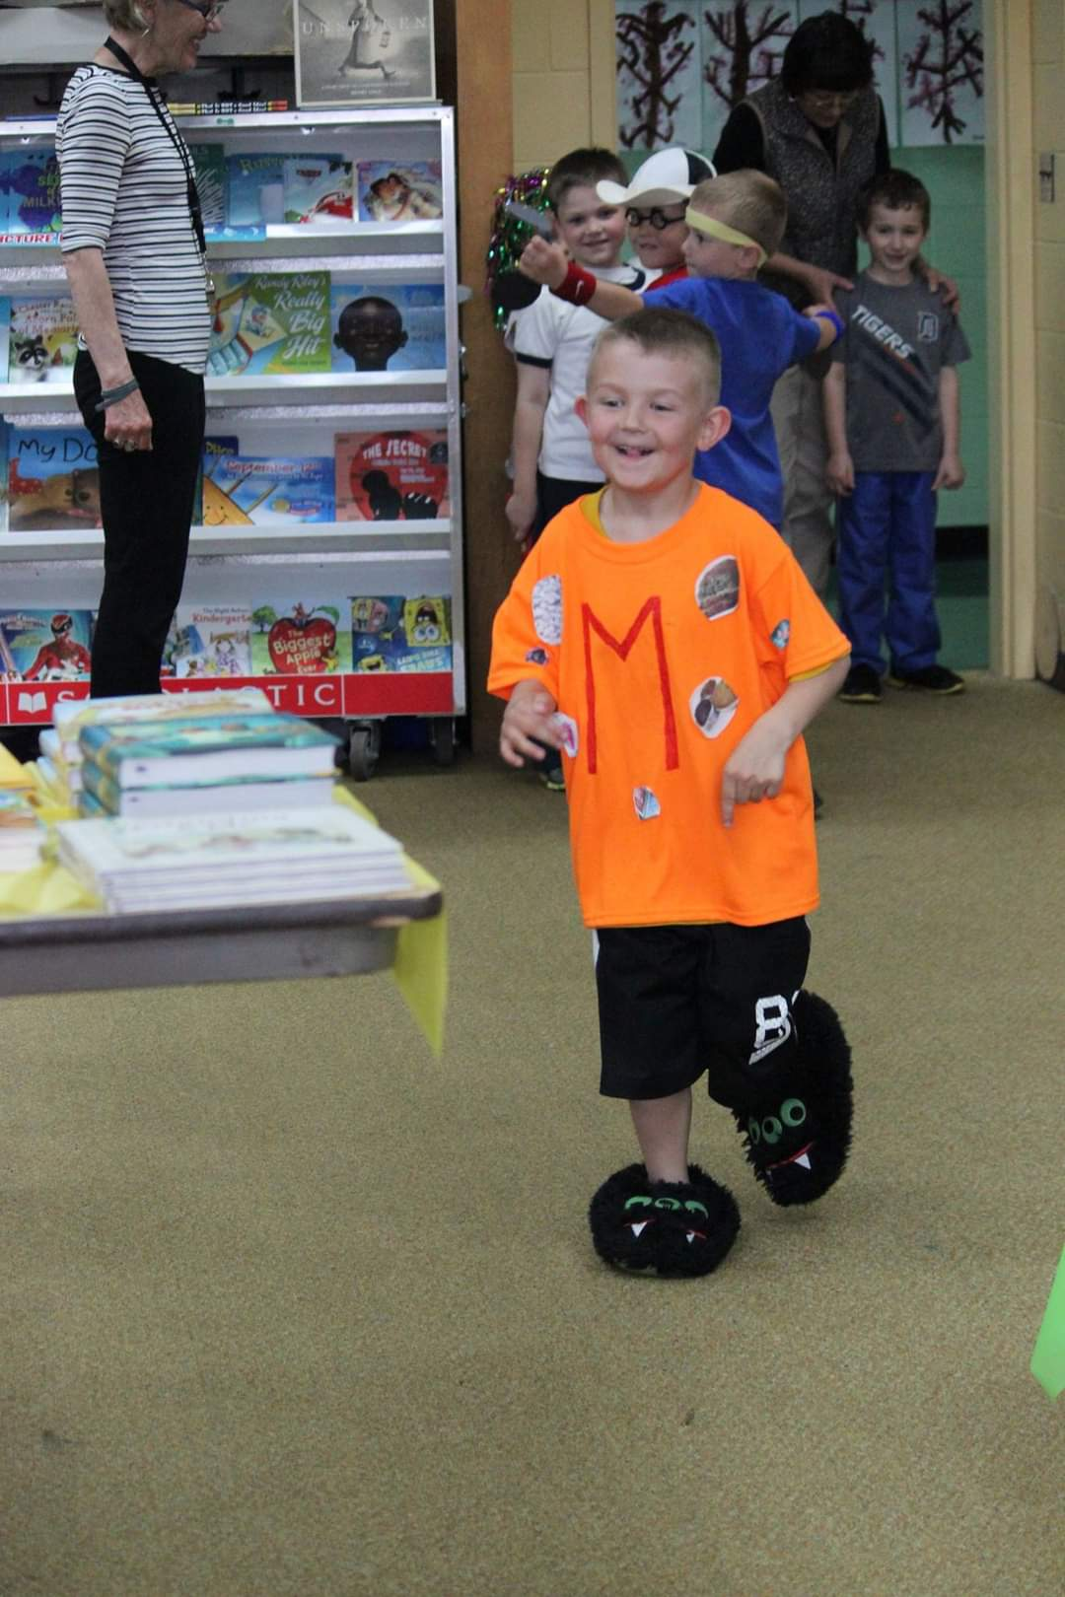
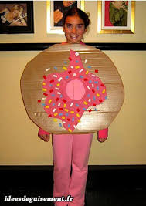
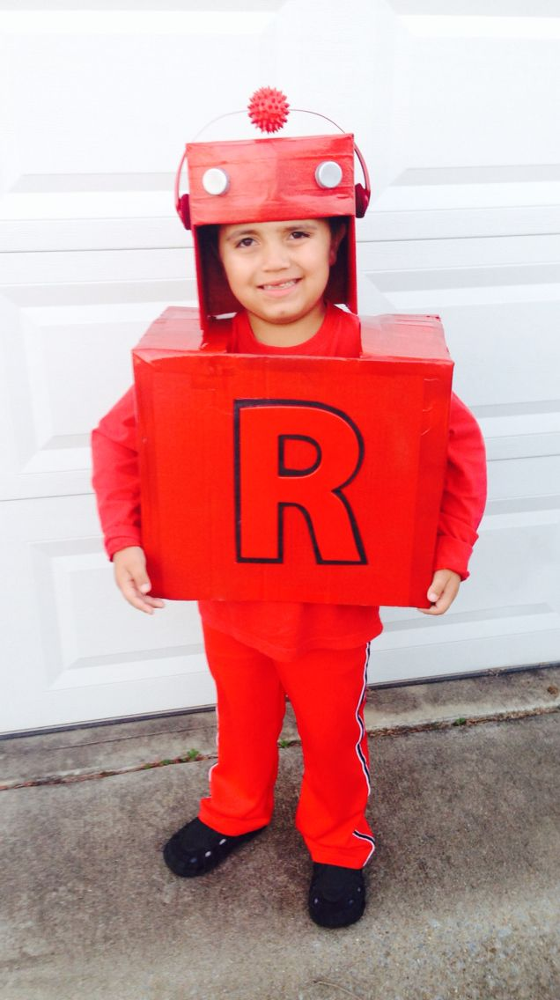
Letter to Parents
Hello Parents! My name is Shelby Roe and I am a junior in Early Childhood Education. I am working on an FCCLA project called Teach and Train. Teach and Train gives me the opportunity to create a lesson plan for the day based off of a book. I have chosen to use the book Chicka Chicka Boom Boom. The story is mainly about the alphabet. Mrs. Thorp and I have come up with the idea of having your children dress as a letter for the day! Each child is assigned a letter below and examples will be provided, but you can choose something different. We encourage you to collaborate with your child to decide what they want to dress as! If you have any questions, feel free to contact Mrs. Thorp or myself! 2sroe@pentacareercenter.org athorp@pentacc.org or 419-661-6369.
*******************************************************************************
Sebastian- P - penguin, pig, panda, pineapple
Harper- C - cat, camera, cookie, carpenter
Maverick- D - dog, doctor, dragon, dinosaur
Paxton- O - octopus, octagon, orangutan, orange
Storm- A - apple, airplane, actor, astronaut
Jaxon- M - monster, monkey, moose, magician

Slide 17
Timing | Content | Activity/ Instructional Methods | Supplies Needed
2-3 Minutes | Morning Question/ Greeting | Ask children “Have you ever climbed a tree? Yes or No” | White Board and marker
10-15 Minutes | Morning activities and free play afterwards | Math Tree Sensory Table Alphabet Computer Game | Tree with Numbers and a big die Sand and Letters Computer
10 Minutes | Snack | Fine Motor Skills | Pretzel rods Green apple slices Candy hearts Blueberries
20 Minutes | Reading Story/ Felt Board | Reading the story “Chicka Chicka Boom Boom” by Bill Martin Jr. and John Archambault, and then working with the felt board | Felt Board Alphabet Felt Board Pieces Book
20-25 Minutes | Small Group | Name and Letter Tree Activity Finger Painting and Stamp Activity Coconut Exploration | Pre-cut letters and tree parts and Glue Sticks Stamps and ink Green and Brown Paint and aprons Coconut, Knife, and a bucket of water
20-25 Minutes | Music and Movement | Chicka Chicka Boom Boom Alphabet Song | -Smart Board -Computer
***ALL | COPYRIGHTED | MATERIAL IS LISTED IN WORK | CITED PAGE

Slide 18
I read the book “Chicka Chicka Boom Boom” by Bill Martin Jr. and John Archambault to the preschoolers during my lesson plan. The activities were based on this book.
Instructional strategies for the activities included cooperative learning, differentiating instruction, and movement.

Slide 19
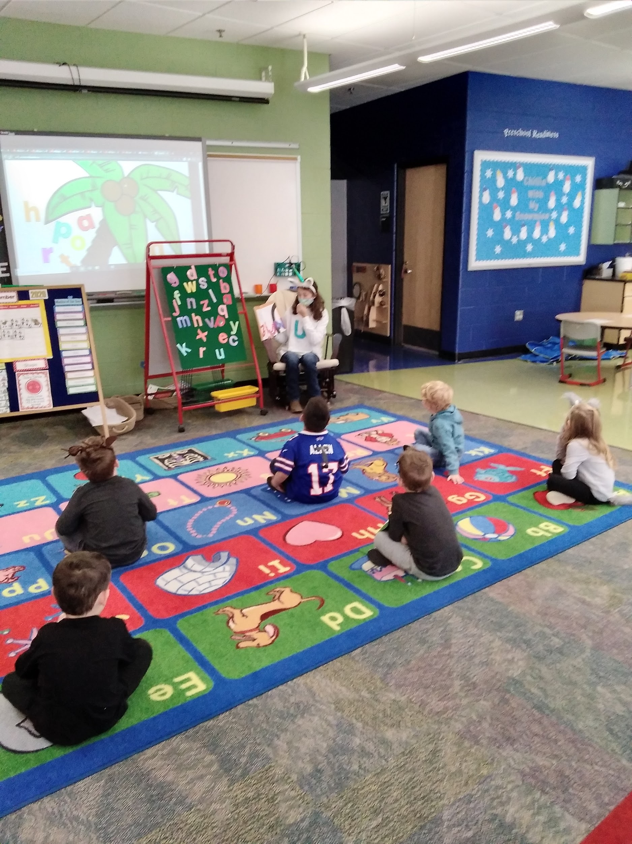
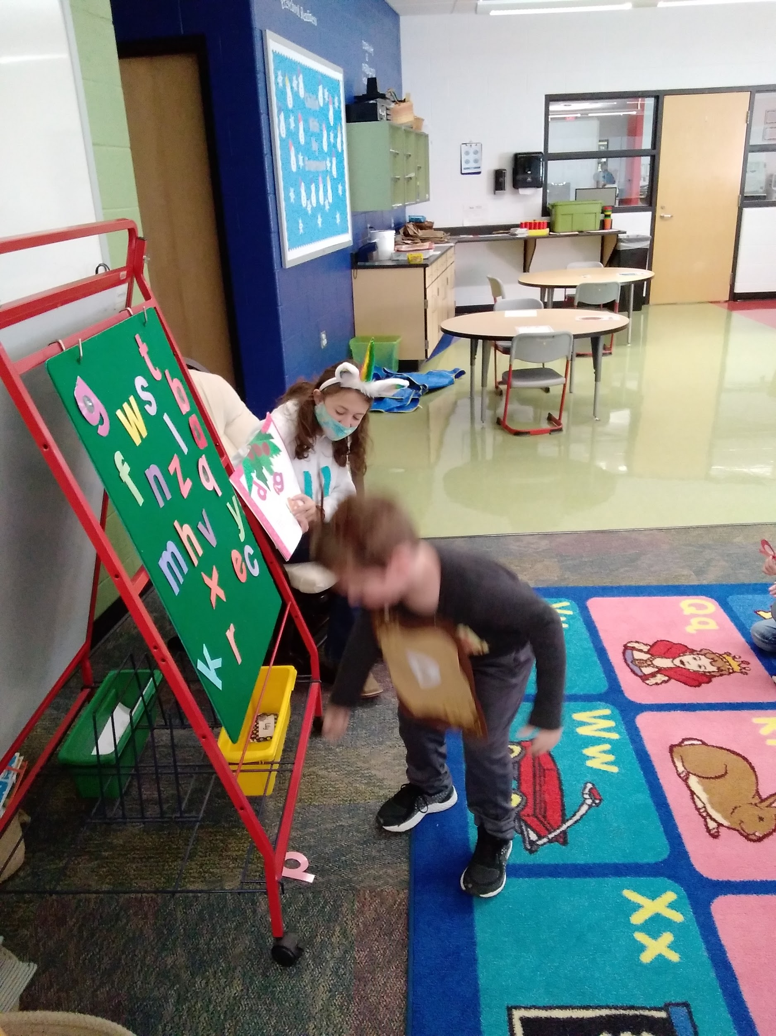
Above: Maverick is putting the letter D, which correlates to the letter on his shirt, onto the felt board as I read the story. This helps him learn many skills such as sequencing
Left: The children listen as I read the book “Chicka Chicka Boom Boom”.
Story and Felt Activity

Slide 20
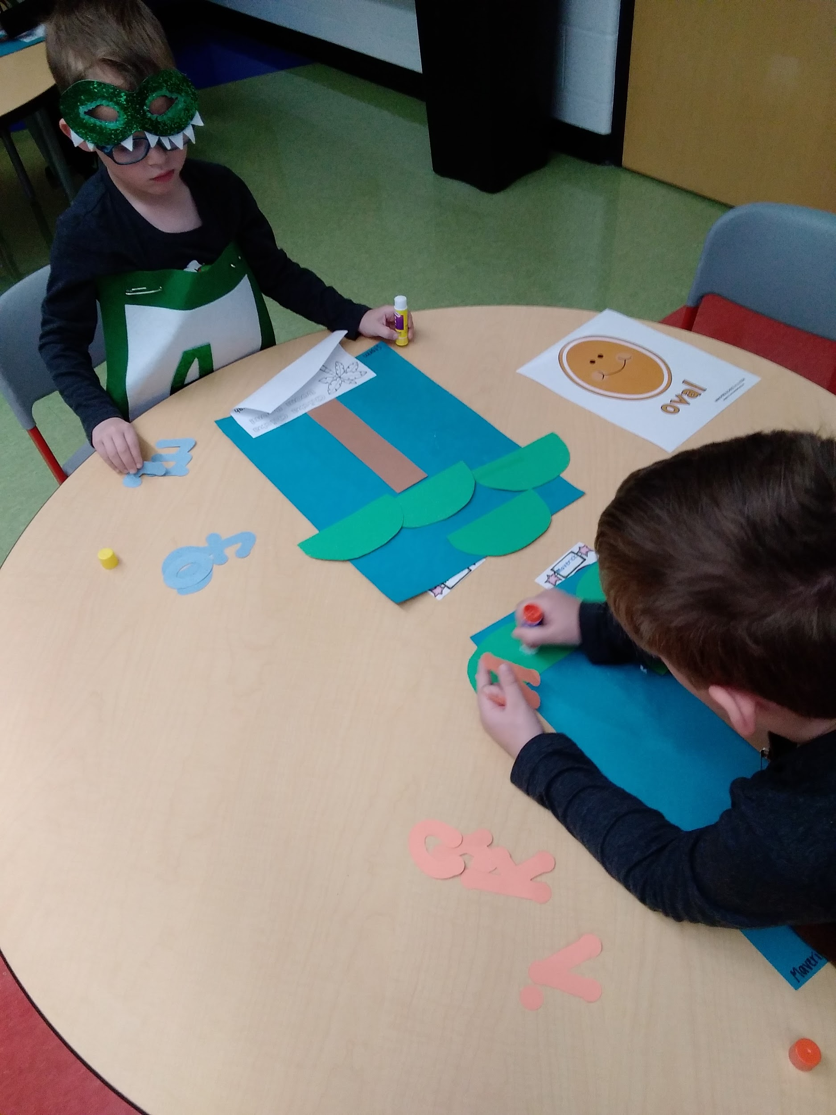
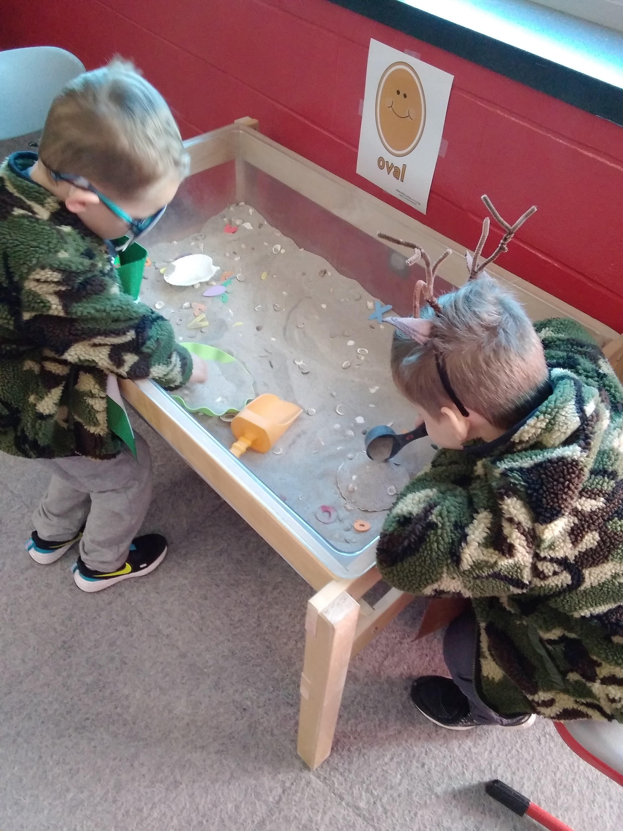
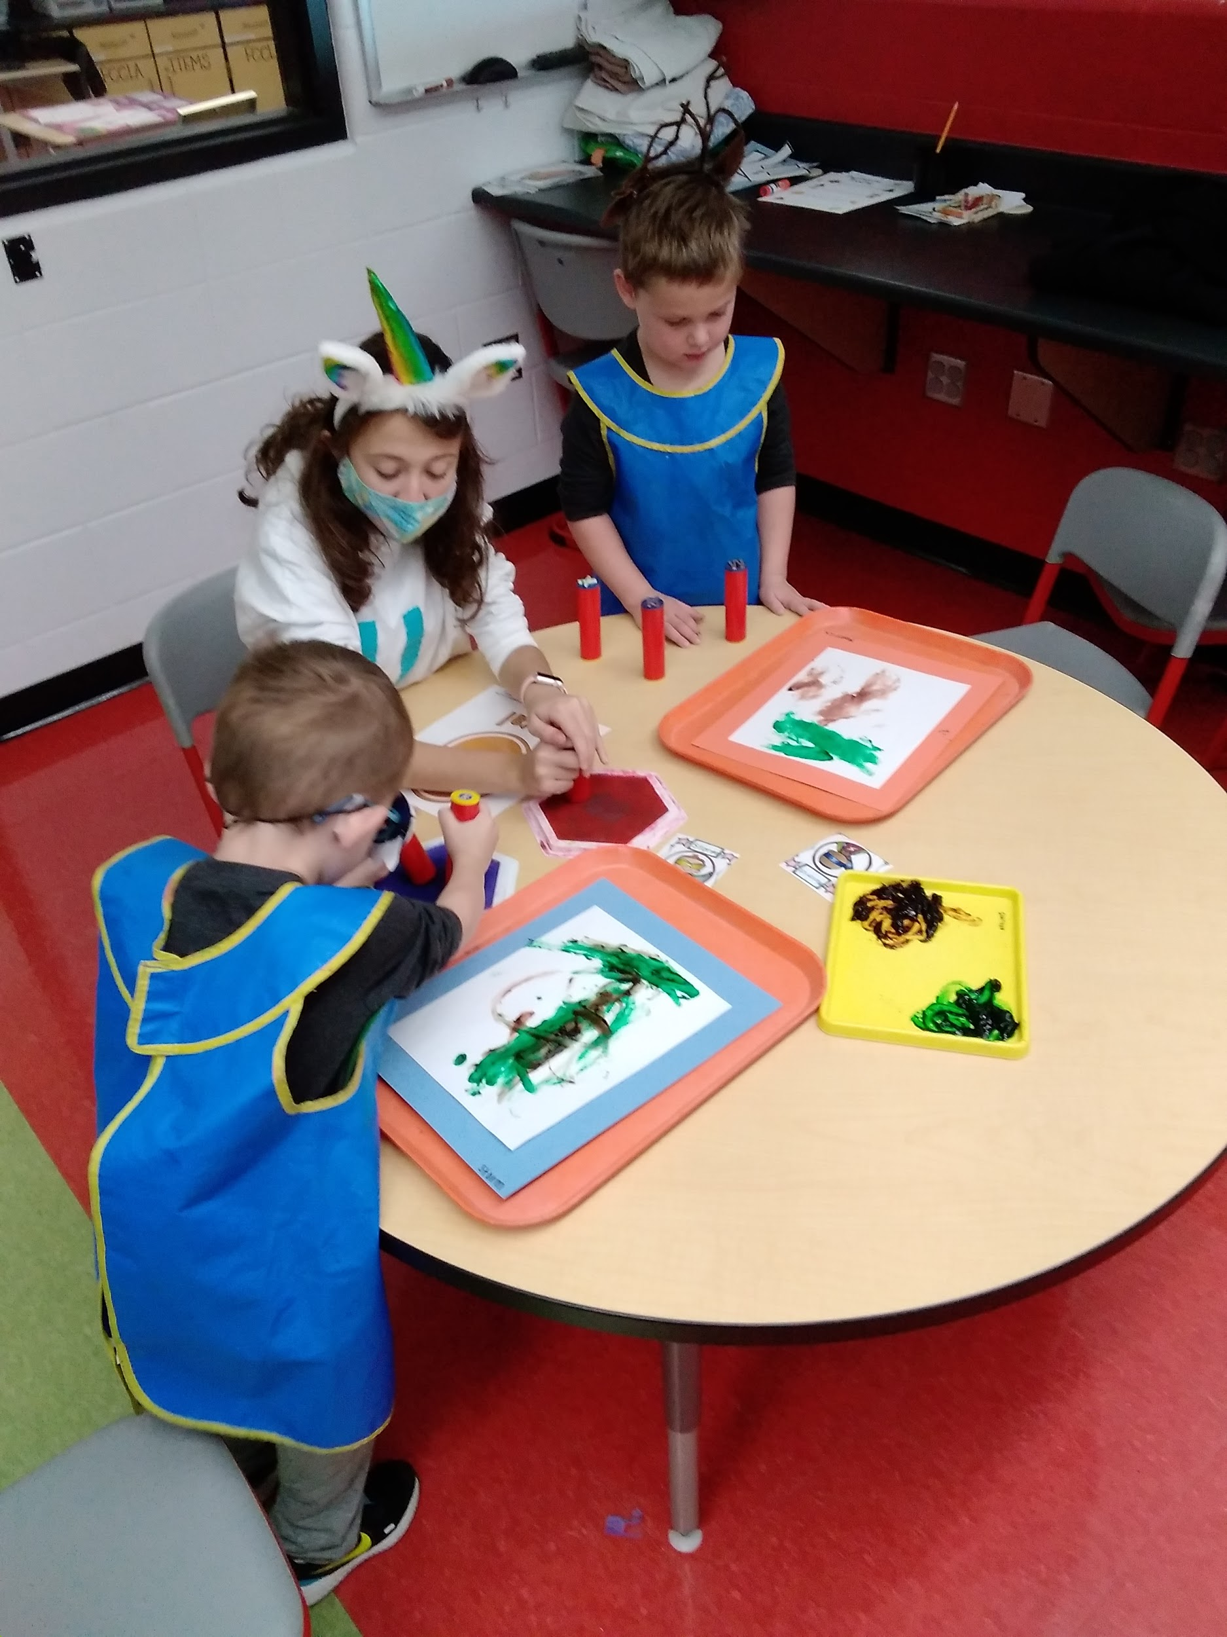
Letters of Name Tree Activity
Sensory Table: Digging for Letters
Tree Finger-Painting and Stamp Activity
Art and Sensory

Slide 21
Preschool Teacher Self Evaluation
What did you enjoy most about your Teaching day?
I enjoyed watching them put together their snack and seeing all of their creative outfits that they came up with!
What was the most difficult part of being a teacher?
The most difficult part of being teacher was trying to keep everyone engaged and on task, and trying to explain the activity in the learning style that the students learned best with.
If you could do something (activity/lesson) over, what would it be and why?
I would redo the coconut activity, I had a difficult time opening the coconut and wasted time with that where if I would have practiced and researched opening a coconut beforehand I wouldn’t have spent as much time and instead could have had more quality time on showing and explaining the inside of a coconut.
Overall: Being a teacher requires lots of patience, practicing and planning.
What was your favorite activity that you planned and why?
My favorite activity I planned was the painting and stamping activity because the children loved being able to choose their paint colors and use those different colors to create letters on the paper.
Did one child stand out in your day- something they did or said or how they did an activity?
Sebastian stood out because he was excited to do all the activities and took his time finger painting the tree. Normally, Sebastian is not a patient child so seeing him take his time on the finger painting tree was great to witness.
Why is it important to research, plan, and organize for your teaching day?
It’s important so as a teacher you don’t get overwhelmed or become upset if something goes wrong and to be able to recover from mistakes. It is also good to have all your materials ready to go and prepared so you spend less time getting things ready and more time engaging with the students.
Notes:
Every good teacher should take time and go back to self reflect on a daily lesson plan...

Slide 22
Specific Plans to Improve Lesson
Have the children shout out each letter while reading the story to help them identify each letter.
Having a better math activity where they could work with more numbers and have it more hands on with concrete objects for the children to hold and manipulate.

Slide 23
Evidence of Prior Presentations

Slide 24
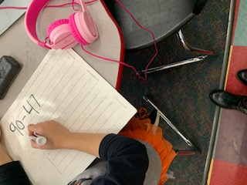
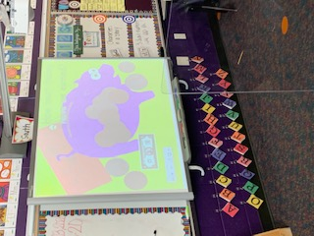
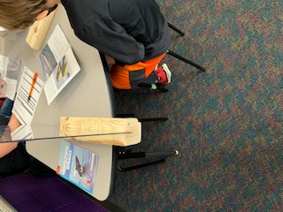
My Shadowing Experience
Students watched videos on their school computers with their own headphones, because of COVID-19, and then solved problems afterwards.
Students learned counting and the value of different coins through technology by creating a certain amount of money in the piggy bank.
Students worked with the teacher in small groups and took turns reading parts of the story, but had to have dividers between them because of COVID-19.

Slide 25
Shadowing Reflection Summary
Date of Shadow: November 13, 2020 from 9:00 am to 12:30 pm
The first thing that I immediately noticed were the safety precautions put in place due to Covid 19. Some items included plexiglass between the students, students were required to bring in their headphones, no circle or group activities were completed, and I was unable to be within 6 feet of the students for more than 15 minutes at a time. I also was unable to attend the clap out rally with the class at the end of the day.
My shadowing experience took place on Friday, November 13, 2020 where I shadowed Mrs. Heidi Feehan, a second grade teacher at Otsego Elementary School. Otsego is located in Haskins, Ohio, considering it a rural area school.
I shadowed Mrs. Feehan because she has 19 years of teaching elementary school-aged children all in the same district. She ensures her students get the best education possible and cares for every single one of them. I was able to observe her day to day routine, including grading student papers and how she runs the classroom during a pandemic.
The Otsego High School football team had a championship game that Friday night. The students were able to create posters for the football players to cheer them on at a clap out later that day.

Slide 26
Shadowing Reflection
She had rewards for students who were on task and were listening in which they could receive prizes from collecting enough rewards.
The curriculum seemed age-appropriate and they were challenged, but not to a difficult extent.
She took turns having the children count the coins and their values and had them do lots of silent work, especially because of COVID-19.
She had a schedule on the board of what they are expected to be doing, and they know the daily routine by memory.

Slide 27
Otsego Local Schools
Shelby spent the morning in our 2nd grade classroom. She walked around and talked/interacted with the students.
She also checked math homework for me and hung student work on a bulletin board.
She was delightful and she is always welcome to spend time in our classroom!
Thank you!
Heidi Feehan
--
Heidi Feehan
2nd Grade Teacher
Otsego Local Schools
hfeehan@otsegoknights.org

Slide 28
November 12, 2020
Dear Whom It May Concern,
My name is Ashley Thorp and I am the Head Preschool Teacher at Penta Early Learning Center. I am writing to confirm that Shelby Roe completed a shadow experience in my preschool classroom. Shelby was able to observe the daily activities and schedule. After a while, she was then able to create her own activities and run the classroom independently. In the room, aiding her, she had a classroom helper and myself. Shelby was able to create a hands on and interactive lesson plans. Before her teaching day, Shelby was able to meet with me and discuss how to approach each lesson to be the best teacher for the students.
Shelby worked kindly with all of the children and understood that sometimes things just do not go as planned. Shelby showed great flexibility during these times. This experience gave her the opportunity to see what happens in a preschool classroom as well as what all the responsibilities are as a head preschool teacher.
Sincerely,
Ashley Thorp
PreSchool Technician
Penta Career Center
athorp@pentacc.org

Slide 29
February 8, 2021
To Whom It May Concern,
Shelby Roe has been a student in the Early Childhood Education Program for one year. As a junior student, she is currently working on gaining the skills and background knowledge needed to become an effective preschool teacher.
This year Shelby is observing in the infant classroom at Penta Career Center. During this time Mrs. Shumpert, the infant teacher, is mentoring her. This experience allows her to learn how to complete and implement lesson plan activities for infants and toddlers as well as learn basic care and routine activities.
She also is observing in the preschool classroom at Penta Career Center. During this time Mrs. Thorp, the preschool teacher, is mentoring her. In the preschool classroom, she is learning how to complete and implement lesson plan activities for preschoolers as well as gain a clear understanding of preschool licensing requirements.
Shelby had the opportunity to job shadow at a neighboring elementary classroom. Ms. Heidi Feehan, a second grade teacher at Otsego Local Schools mentored her. This experience allowed Shelby to work in a building with grades K-3rd where she could see all the teachers and students come and go through the halls and out to recess. It has exposed her to the career of Elementary Education.
These three experiences have been a good experience for Shelby Roe since she is interested in being an educator. She is fortunate that she has been able to experience ages birth through kindergarten so she can determine her life goals.
The Teach and Train event has also helped Shelby with career planning. She has researched colleges, interviewed teachers, and followed our preschool teacher around to see what it is like from the beginning to the end of the day. Overall, Shelby is a dedicated student who has gained vital experience to help make her decision on what college to attend and what degree to work toward for a successful career.
Sincerely,
Amy Carey Early Childhood Education Instructor 9301 Buck Road Perrysburg, Ohio 43551 (419) 66-1120 ext. 1210

Slide 30
Evidence of Technology Used

Slide 31
Technology Used
Computer-
Created my portfolio pages on Google Drive
Completed research on careers
Ran educational games for the students
Camera and iPad-
Took pictures with during my shadowing experience and my lesson with the preschoolers
Smart Board-
Displayed videos and played songs that I sang with the children

Slide 32
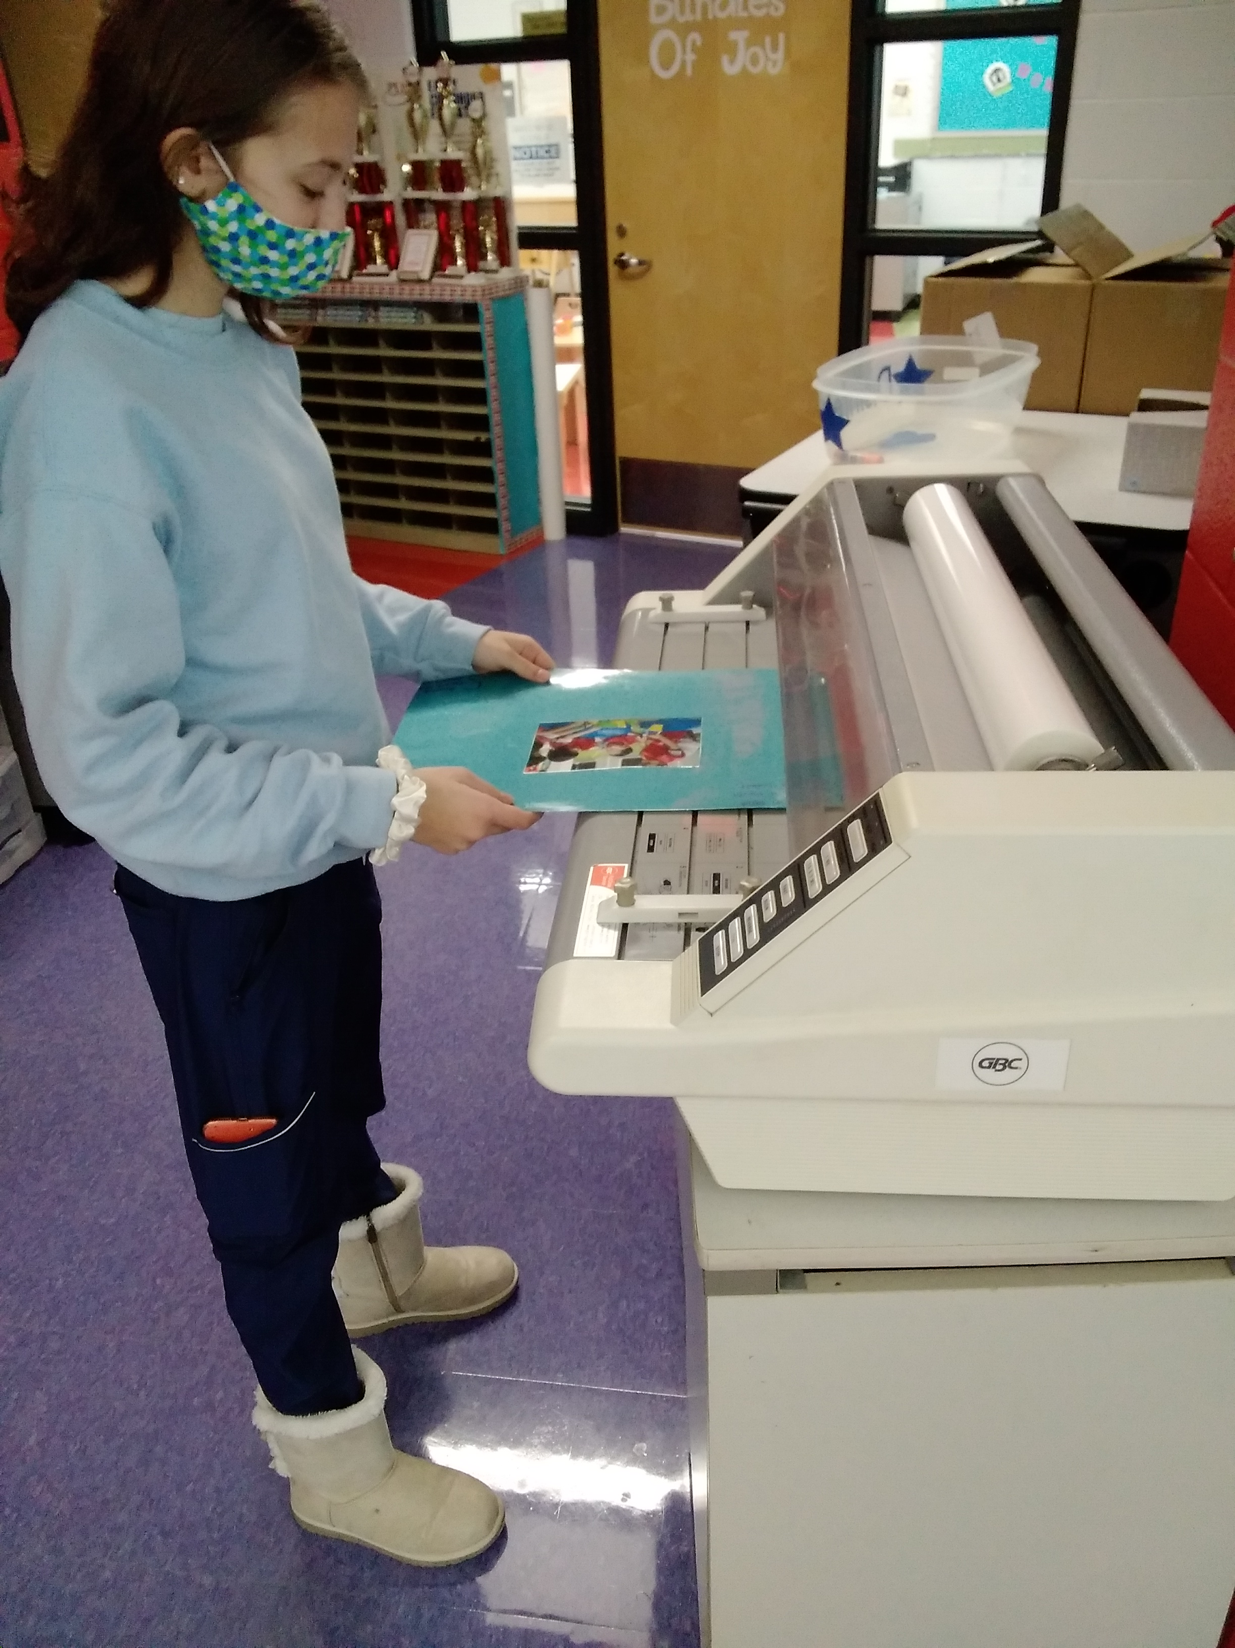
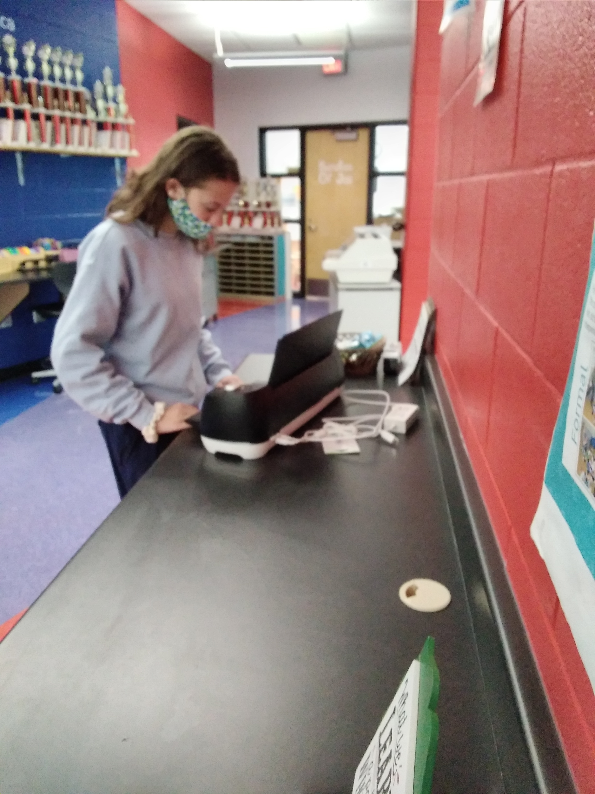
Laminator-
Laminated educational materials to use for my lesson plan to make items more durable
Cricut-
Created items to use for my teaching day.

Slide 33
Work Cited

Slide 34
Work Cited
“
Chicka Chicka Boom Boom, 2021, learnwithhomer.com/library/story/chicka-chicka-boom-boom/.
Chicka Chicka Boom Boom.” You Tube, uploaded by Andre Penn, 18 May 2020, www.youtube.com/watch?v=sAnSnkIrg2E.
Herr, Judy Dr. The Observation Guide: Working with Young Children. Seventh ed., Goodheart-Willcox Co., 2012.
“Home.” Ohio FCCLA, 29 May 2020, www.ohiofccla.org/.
“Kindergarten and Elementary School Teachers : Occupational Outlook Handbook.” U.S. Bureau of Labor Statistics, U.S. Bureau of Labor Statistics, 1 Sept. 2020, www.bls.gov/ooh/education-training-and-library/kindergarten-and-elementary-school-teachers.htm.
Martin Jr., Bill and Archambault, John. Chicka Chicka Boom Boom. Simon & Schuster, 1989.
“National Standards.” Home, www.leadfcsed.org/national-standards.html.

